Slide 1
Dynamic Scheduling
Tomasulo's Algorithm vs. Scoreboarding
By: Nathan Lentz, Hayden Miedema, and Douglas Money
Notes:
Intro
Names
Our topic is on
Dynamic Scheduling and ways to handle dynamic scheduling using two methods..
Tomasulo’s Algorithm and Scoreboarding.

Slide 2
Overview
Dynamic Scheduling
Review ILP
What is Dynamic Scheduling?
Examples
Issues
Scoreboarding
Background
Useage
Examples
Tomasulo’s Algorithm
Background
Useage
Examples
Notes:
First I will give an overview of discussion today.
We will break the discussion down into 3 main parts.
I will talk about Dynamic Scheduling
Reviewing ILP
I will discuss what Dynamic Scheduling is in comparison to Static Scheduling
Show some examples to get a better more visual understanding of the concept
And finally discuss some Issues that come up when we attempt Dynamic Scheduling.
Nate will discuss a dynamic scheduling method that is Scoreboarding
Hayden will bring us home with a piece on Tomasulo's algorithm for Dynamic Scheduling

Slide 3
The Basics
processors use pipelining techniques to overlap execution of instructions to improve performance.
The overlapping is called Instruction Level Parallelism
Two Approaches to ILP
Static
More Software Reliant
Dynamic
More Hardware Reliant
Notes:
First we felt it was necessary to review some of the basics.
Some we have discussed in class but very necessary to understanding our topic.
We know that processors use pipelining techniques to overlap execution of instructions
in order to improve performance
This overlapping is called Instruction Level Parallelism or ILP
Two Approaches to ILP are Static and Dynamic Scheduling.
Static scheduling is optimized by the compiler and is more reliant on software
Dynamic Scheduling relies on the addition of more complex hardware to allow for out-of-order execution and handle the exceptions that come with out-of order execution.

Slide 4
In Order Execution → Out of Order Execution
Pipelining methods where all of the instructions were executing in-order. The problem with this is that when an instruction needs to stall all of the previous instructions also need to stall. For example say we have the following list of instructions:
add t0,t1,t2
add t3,t0,t4
sub t5,t6,t7
The data hazard highlighted is causing the operation to stall and the sub instruction must wait.
With Dynamic scheduling we are able to take advantage of instruction parallelism. That is, we can allow the instruction behind the stall to proceed without having to wait. In this case the sub instruction could execute without waiting.
This idea is considered out-of-order execution
Notes:
As a review.
In-Order-Execution is a pipelining method where all of the instructions execute the order they are received.
The problem with this is that when an instruction needs to stall all of the instructions behind the instruction need to stall as well.
For example the common RAW data hazard.
The highlighted data hazard is causing the sub instruction to wait until the values are registered appropriately.
This wait can be costly.
It would be great if this sub instruction could just execute out-of-order and that's just what Dynamic Scheduling allows us to do.
That is we can allow the instruction behind the stall to proceed without having to wait.
This case the sub instruction could execute without waiting.
Dynamic Scheduling implies out-of-order execution.

Slide 5
Out-Of-Order Execution
Instructions are issued or decoded in order.
2. Hardware dynamically schedules instructions, deciding what order the instructions can be executed.
3. If there is no dependency then the instruction may be scheduled for execution without waiting for the stalls.
Notes:
For example:
In out-of-order execution
Instructions are issued or decoded in-order
It is the hardware that dynamically schedules instructions, deciding what order the instructions can be executed.
If there is no dependency then the instruction may be scheduled for execution. without waiting for stalls.

Slide 6
Dynamic Scheduling
Pros:
Increase Performance
Less processor stalling
Simplifies the compiler
Handle dependencies unknown at compile time.
Cons:
Added complexity for designing and developing
Partially due to handling of WAR and WAW exceptions.
Notes:
Dynamic scheduling has its advantages and disadvantages.
It increases performance.
It is better at hiding latencies giving us less processor stalling as opposed to an in-order-execution style.
Dynamic scheduling also simplifies the compiler

Slide 7
Dynamic Scheduling
However, if out-of-order execution is allowed, WAR or WAW hazards could arise.
add t0,t1,t2
add t6,t0,t8
sub t8,t10,t14
Add t6,t10,t8
Eliminating these hazards is essential to out-of order execution
Notes:
If out-of-order execution is allowed WAR or WAW hazards could arise.
Elimination these hazards is essential to out-of order execution

Slide 8
Dynamic Scheduling
In order solve the problems of WAR and WAW hazards when dynamic scheduling we present two historical and popular algorithms.
Tomasulo’s Algorithm and Scoreboarding.
Notes:
In order solve the problems of WAR and WAW hazards when dynamic scheduling we present two historical and popular algorithms.
Tomasulo’s Algorithm and Scoreboarding.
I will hand it over to Nate to discuss the Scoreboarding technique.

Slide 9
The Scoreboard - What is it?

Slide 10
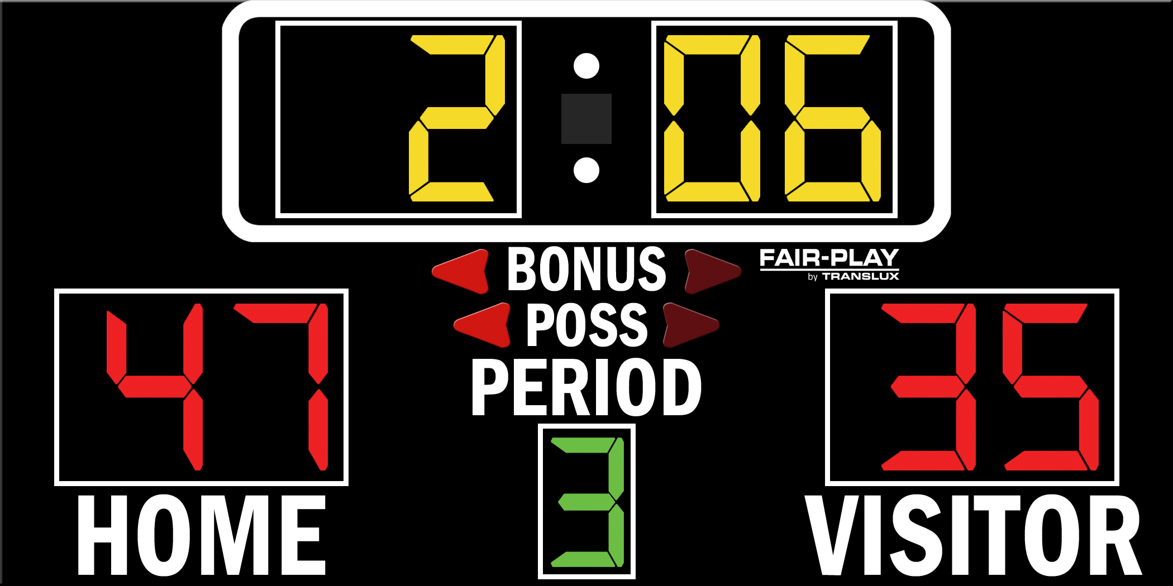

Slide 11
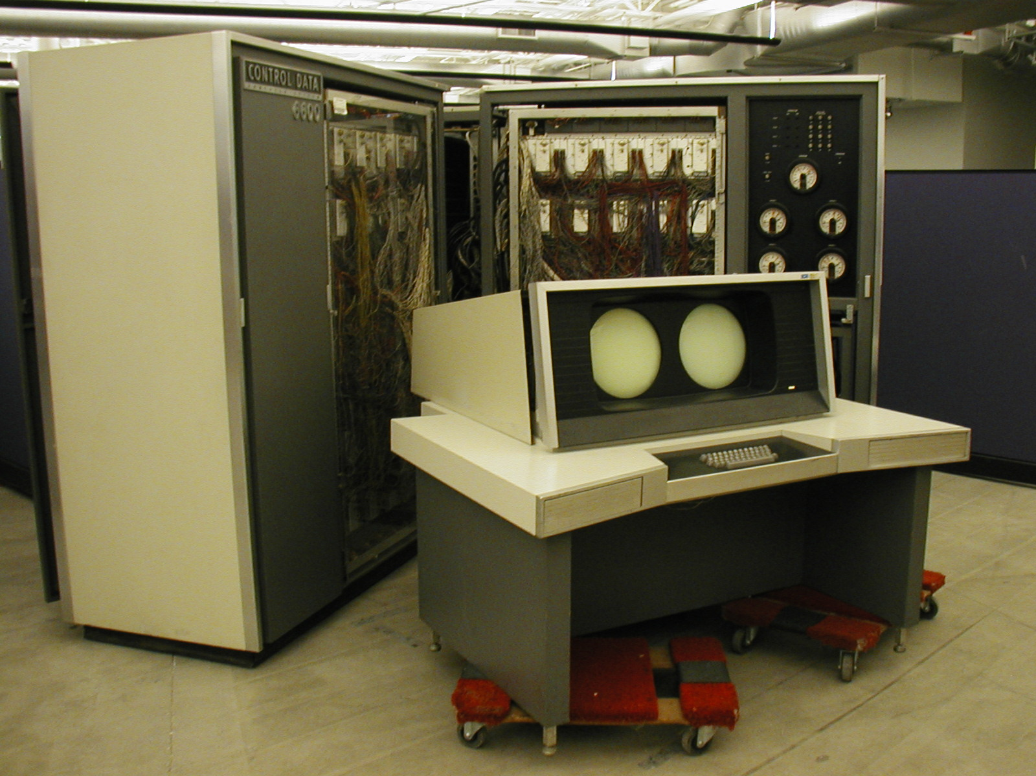

Slide 12
Background Info - Scoreboarding
Named after the CDC 6600 Computer from 1965 which developed this technique
Uses a hardware unit called the scoreboard
Schedules a pipeline so instructions can execute out-of-order when there are no conflicts and when hardware is available
Goal is to maintain an execution rate of one instruction per clock cycle through out-of-order execution
Notes:
http://engineering.dartmouth.edu/courses/engs116/lectures/engs%20116%20lecture%207-05f.ppt.
http://www.inf.ed.ac.uk/teaching/courses/car/Notes/2011-12/lecture08-scoreboarding.pdf
http://euler.mat.uson.mx/~havillam/ca/CS323/0708.cs-323011.html

Slide 13
The Scoreboard - What is it?
The Scoreboard is essentially a table maintained by the hardware that constructs the data dependences
Out-Of-Order execution requires multiple instructions to be in the EX Stage Simultaneously
Achieved with multiple functional units, along with pipelined functional units
All instructions go through the scoreboard
Centralized control of issue, operand reading, execution and writeback
All hazard resolution is centralized in the scoreboard as well
Notes:
Not really a distinction between pipeline functional units or functional units. They’ll logically give us the same result
All controlled through the hardware

Slide 14
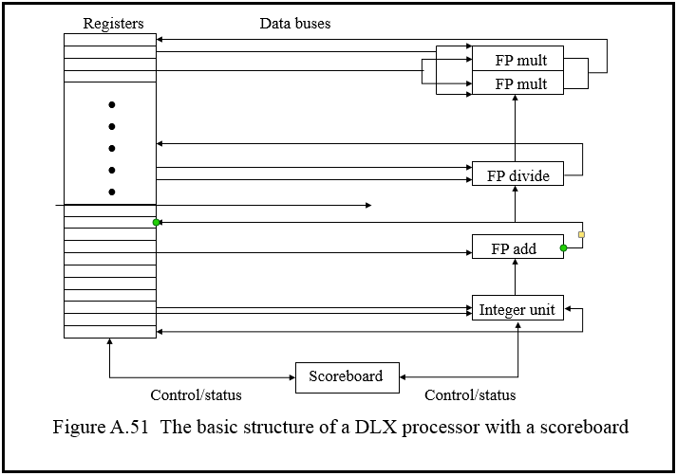
Quick Look - A Simplified Scoreboard
Notes:
Simplified with 5 functional units.
6600 had 11 units where the scoreboard was developed.
Various buses.
Then the scoreboard which controls different functional units and also controls the registers. That means controlling reading status controlling the registers, controlling the functional units. Which is all done with a centralized hardware unit.

Slide 15

The Stages of Scoreboard Control
Issue (ID1)
If the required functional unit is available (no structural hazard), and
No other unit is pending a write to the same register (no WAW)
Issue instruction and update
Always done in program order
Read Operands (ID2)
Wait until there are no data hazards, then read operands
Operand is available if…
No issued instruction will write to it
If the register containing the operand is being written by an active FU (No RAW)
Notes:
ID2 (can be done out of order)
When the source operands are available, the scoreboard tells the functional unit to proceed to read the operands from the registers and begin execution. The scoreboard resolves RAW hazards dynamically in this step, and instructions may be sent into execution out of order.

Slide 16
EX Stage - Scoreboarding
Execute
Operate on operands
The function unit begins execution upon receiving operands. When the result is ready, it notifies the scoreboard that it has completed execution

Slide 17
Write Result Stage - Scoreboarding
WB (Finish Execution)
Once the scoreboard is aware that the functional unit has completed execution, the scoreboard checks for WAR hazards.
If none, write the result
If a WAR exists, stall until no previous instructions have WAR
DIVD F0, F2, F4
ADDD F10, F0, F8
SUBD F8, F8, F14
CDC 6600 would stall SUBD until ADDD reads the operands

Slide 18
Parts of the Scoreboard
Instruction Status: Indicates which of 4 steps the instruction is in

Slide 19
Parts of the Scoreboard
Functional Unit Status: Indicates the state of the functional unit (FU). 9 Fields for each FU
Busy: Indicates if the unit is busy or not
Op: Operation to perform in the unit (+ or -)
Fi: Indicate Destination Register
Fj, Fk: Source Register numbers
Qj, Qk: Functional Units producing instruction’s source registers Fj, Fk
Rj, Rk: Indicate whether or not Fj and Fk are ready (WAR Hazard Prevention)
Notes:
http://ece-research.unm.edu/jimp/611/slides/chap4_3.html

Slide 20
Parts of the Scoreboard
Register Result Status: Indicates which functional unit will write each register, if one exists.
If register is not the destination of an issued instruction, field will indicate no FU

Slide 21
Scoreboarding Example
(Brace yourself)

Slide 22
Instruction Status
CYCLE 1
Instruction |  | j | k | Issue | Read Operand | Execute Complete | Write Result
LD | F6 | 34+ | R3
LD | F2 | 45+ | R3
MULT1 | F0 | F2 | F4
SUBD | F8 | F6 | F2
DIVD | F10 | F0 | F6
ADDD | F6 | F8 | F2
Issue LD #1
1
Shows which cycle the operation occurred
Functional Unit Status
Dest S1 S2 FU for j FU for k Fj? Fk?
Time Name Busy Op Fi Fj Fk Qj Qk Rj Rk
Integer
Mult1
Mult2
Add
Divide
Yes
No
No
No
No
Load
F6
R2
Yes
Register Result Status
F0 | F2 | F4 | F6 | F8 | F10 | F12 | ... | F30
FU
Integer
Notes:
LD - 1 cycle
ADDDs + SUBs - 2 Cycles
MULT - 10 cycles
DIVIDE - 40 cycles

Slide 23
Instruction Status
CYCLE 2
Instruction |  | j | k | Issue | Read Operand | Execute Complete | Write Result
LD | F6 | 34+ | R3 |  | 2
LD | F2 | 45+ | R3
MULT1 | F0 | F2 | F4
SUBD | F8 | F6 | F2
DIVD | F10 | F0 | F6
ADDD | F6 | F8 | F2
LD #2 can’t issue since integer FU is busy. MULT can’t issue because we require in-order issue.
1
Functional Unit Status
Dest S1 S2 FU for j FU for k Fj? Fk?
Time Name Busy Op Fi Fj Fk Qj Qk Rj Rk
Integer
Mult1
Mult2
Add
Divide
Yes
No
No
No
No
Load
F6
R2
Yes
Register Result Status
F0 | F2 | F4 | F6 | F8 | F10 | F12 | ... | F30
FU
Integer
Notes:
LD - 1 cycle
ADDDs + SUBs - 2 Cycles
MULT - 10 cycles
DIVIDE - 40 cycles

Slide 24
Instruction Status
CYCLE 4
Instruction |  | j | k | Issue | Read Operand | Execute Complete | Write Result
LD | F6 | 34+ | R3 |  | 2 | 3 | 4
LD | F2 | 45+ | R3
MULT1 | F0 | F2 | F4
SUBD | F8 | F6 | F2
DIVD | F10 | F0 | F6
ADDD | F6 | F8 | F2
1
Dest S1 S2 FU for j FU for k Fj? Fk?
Functional Unit Status
Time Name Busy Op Fi Fj Fk Qj Qk Rj Rk
Integer
Mult1
Mult2
Add
Divide
Yes
No
No
No
No
Load
F6
R2
Yes
Register Result Status
F0 | F2 | F4 | F6 | F8 | F10 | F12 | ... | F30
FU
Integer
Notes:
LD - 1 cycle
ADDDs + SUBs - 2 Cycles
MULT - 10 cycles
DIVIDE - 40 cycles

Slide 25
Instruction Status
CYCLE 5
Instruction |  | j | k | Issue | Read Operand | Execute Complete | Write Result
LD | F6 | 34+ | R3 | 1 | 2 | 3 | 4
LD | F2 | 45+ | R3 | 5
MULT1 | F0 | F2 | F4
SUBD | F8 | F6 | F2
DIVD | F10 | F0 | F6
ADDD | F6 | F8 | F2
LD #2 since integer unit is now free
Dest S1 S2 FU for j FU for k Fj? Fk?
Functional Unit Status
Time Name Busy Op Fi Fj Fk Qj Qk Rj Rk
Integer
Mult1
Mult2
Add
Divide
Yes
No
No
No
No
Load
F2
R3
Yes
Register Result Status
F0 | F2 | F4 | F6 | F8 | F10 | F12 | ... | F30
 | Integer
FU
Notes:
LD - 1 cycle
ADDDs + SUBs - 2 Cycles
MULT - 10 cycles
DIVIDE - 40 cycles

Slide 26
Instruction Status
CYCLE 6
Instruction |  | j | k | Issue | Read Operand | Execute Complete | Write Result
LD | F6 | 34+ | R3 | 1 | 2 | 3 | 4
LD | F2 | 45+ | R3 | 5 | 6
MULT1 | F0 | F2 | F4 | 6
SUBD | F8 | F6 | F2
DIVD | F10 | F0 | F6
ADDD | F6 | F8 | F2
Issue the MULT Instruction
Dest S1 S2 FU for j FU for k Fj? Fk?
Functional Unit Status
Time Name Busy Op Fi Fj Fk Qj Qk Rj Rk
Integer
Mult1
Mult2
Add
Divide
Yes
No
No
No
No
Load
Mult
F2
F0
F2
R3
F4
Integer
No
Yes
Yes
Register Result Status
F0 | F2 | F4 | F6 | F8 | F10 | F12 | ... | F30
Mult1 | Integer
FU
Notes:
LD - 1 cycle
ADDDs + SUBs - 2 Cycles
MULT - 10 cycles
DIVIDE - 40 cycles

Slide 27
Instruction Status
CYCLE 7
Instruction |  | j | k | Issue | Read Operand | Execute Complete | Write Result
LD | F6 | 34+ | R3 | 1 | 2 | 3 | 4
LD | F2 | 45+ | R3 | 5 | 6 | 7
MULT1 | F0 | F2 | F4 | 6
SUBD | F8 | F6 | F2 | 7
DIVD | F10 | F0 | F6
ADDD | F6 | F8 | F2
MULT can’t read operands (F2) because LD #2 has not finished
Issue SUBD
Dest S1 S2 FU for j FU for k Fj? Fk?
Functional Unit Status
Time Name Busy Op Fi Fj Fk Qj Qk Rj Rk
Integer
Mult1
Mult2
Add
Divide
Yes
Yes
No
Yes
No
Load
Mult
Sub
F2
F0
F8
F2
F6
R3
F4
F2
Integer
Integer
No
Yes
Yes
Yes
No
Register Result Status
F0 | F2 | F4 | F6 | F8 | F10 | F12 | ... | F30
Mult1 | Integer |  |  | Add
FU
Notes:
LD - 1 cycle
ADDDs + SUBs - 2 Cycles
MULT - 10 cycles
DIVIDE - 40 cycles

Slide 28
Instruction Status
CYCLE 8a
Instruction |  | j | k | Issue | Read Operand | Execute Complete | Write Result
LD | F6 | 34+ | R3 | 1 | 2 | 3 | 4
LD | F2 | 45+ | R3 | 5 | 6 | 7
MULT1 | F0 | F2 | F4 | 6
SUBD | F8 | F6 | F2 | 7
DIVD | F10 | F0 | F6 | 8
ADDD | F6 | F8 | F2
DIVD issues but both MULT and SUBD both are waiting for F2
Dest S1 S2 FU for j FU for k Fj? Fk?
Functional Unit Status
Time Name Busy Op Fi Fj Fk Qj Qk Rj Rk
7
Integer
Mult1
Mult2
Add
Divide
Yes
Yes
No
Yes
Yes
Load
Mult
Sub
Div
F2
F0
F8
F10
F2
F6
F0
R3
F4
F2
F6
Integer
Mult1
Integer
No
Yes
No
Yes
Yes
No
Yes
Register Result Status
F0 | F2 | F4 | F6 | F8 | F10 | F12 | ... | F30
Mult1 | Integer |  |  | Add | Divide
FU
Notes:
LD - 1 cycle
ADDDs + SUBs - 2 Cycles
MULT - 10 cycles
DIVIDE - 40 cycles

Slide 29
Instruction Status
CYCLE 8b
Instruction |  | j | k | Issue | Read Operand | Execute Complete | Write Result
LD | F6 | 34+ | R3 | 1 | 2 | 3 | 4
LD | F2 | 45+ | R3 | 5 | 6 | 7 | 8
MULT1 | F0 | F2 | F4 | 6
SUBD | F8 | F6 | F2 | 7
DIVD | F10 | F0 | F6 | 8
ADDD | F6 | F8 | F2
LD #2 writes to F2
Dest S1 S2 FU for j FU for k Fj? Fk?
Functional Unit Status
Time Name Busy Op Fi Fj Fk Qj Qk Rj Rk
Integer
Mult1
Mult2
Add
Divide
No
Yes
No
Yes
Yes
Mult
Sub
Div
F0
F8
F10
F2
F6
F0
F4
F2
F6
Mult1
Yes
Yes
No
Yes
No
Yes
Register Result Status
F0 | F2 | F4 | F6 | F8 | F10 | F12 | ... | F30
Mult1 |  |  |  | Add | Divide
FU
Notes:
LD - 1 cycle
ADDDs + SUBs - 2 Cycles
MULT - 10 cycles
DIVIDE - 40 cycles

Slide 30
Instruction Status
CYCLE 9
Instruction |  | j | k | Issue | Read Operand | Execute Complete | Write Result
LD | F6 | 34+ | R3 | 1 | 2 | 3 | 4
LD | F2 | 45+ | R3 | 5 | 6 | 7 | 8
MULT1 | F0 | F2 | F4 | 6 | 9
SUBD | F8 | F6 | F2 | 7 | 9
DIVD | F10 | F0 | F6 | 8
ADDD | F6 | F8 | F2
Now MULT and SUBD can both read F2.
Functional Unit Status
Time Name Busy Op Fi Fj Fk Qj Qk Rj Rk
10
2
Integer
Mult1
Mult2
Add
Divide
No
Yes
No
Yes
Yes
Mult
Sub
Div
F0
F8
F10
F2
F6
F0
F4
F2
F6
Mult1
Yes
Yes
No
Yes
No
Yes
Register Result Status
F0 | F2 | F4 | F6 | F8 | F10 | F12 | ... | F30
Mult1 |  |  |  | Add | Divide
FU
Notes:
LD - 1 cycle
ADDDs + SUBs - 2 Cycles
MULT - 10 cycles
DIVIDE - 40 cycles

Slide 31
Instruction Status
CYCLE 11
Instruction |  | j | k | Issue | Read Operand | Execute Complete | Write Result
LD | F6 | 34+ | R3 | 1 | 2 | 3 | 4
LD | F2 | 45+ | R3 | 5 | 6 | 7 | 8
MULT1 | F0 | F2 | F4 | 6 | 9
SUBD | F8 | F6 | F2 | 7 | 9 | 11
DIVD | F10 | F0 | F6 | 8
ADDD | F6 | F8 | F2
ADDD can’t start because the add FU is busy
Dest S1 S2 FU for j FU for k Fj? Fk?
Functional Unit Status
Time Name Busy Op Fi Fj Fk Qj Qk Rj Rk
8
0
Integer
Mult1
Mult2
Add
Divide
No
Yes
No
Yes
Yes
Mult
Sub
Div
F0
F8
F10
F2
F6
F0
F4
F2
F6
Mult1
Yes
Yes
No
Yes
No
Yes
Register Result Status
F0 | F2 | F4 | F6 | F8 | F10 | F12 | ... | F30
Mult1 |  |  |  | Add | Divide
FU
Notes:
LD - 1 cycle
ADDDs + SUBs - 2 Cycles
MULT - 10 cycles
DIVIDE - 40 cycles

Slide 32
Instruction Status
CYCLE 12
Instruction |  | j | k | Issue | Read Operand | Execute Complete | Write Result
LD | F6 | 34+ | R3 | 1 | 2 | 3 | 4
LD | F2 | 45+ | R3 | 5 | 6 | 7 | 8
MULT1 | F0 | F2 | F4 | 6 | 9
SUBD | F8 | F6 | F2 | 7 | 9 | 11 | 12
DIVD | F10 | F0 | F6 | 8
ADDD | F6 | F8 | F2
SUBD finishes and DIVD now waits for F0
Dest S1 S2 FU for j FU for k Fj? Fk?
Functional Unit Status
Time Name Busy Op Fi Fj Fk Qj Qk Rj Rk
7
Integer
Mult1
Mult2
Add
Divide
No
Yes
No
No
Yes
Mult
Div
F0
F10
F2
F0
F4
F6
Mult1
Yes
No
Yes
Yes
Register Result Status
F0 | F2 | F4 | F6 | F8 | F10 | F12 | ... | F30
Mult1 |  |  |  | Add | Divide
FU
Notes:
LD - 1 cycle
ADDDs + SUBs - 2 Cycles
MULT - 10 cycles
DIVIDE - 40 cycles

Slide 33
Instruction Status
CYCLE 13
Instruction |  | j | k | Issue | Read Operand | Execute Complete | Write Result
LD | F6 | 34+ | R3 | 1 | 2 | 3 | 4
LD | F2 | 45+ | R3 | 5 | 6 | 7 | 8
MULT1 | F0 | F2 | F4 | 6 | 9
SUBD | F8 | F6 | F2 | 7 | 9 | 11 | 12
DIVD | F10 | F0 | F6 | 8
ADDD | F6 | F8 | F2 | 13
ADDD issues
Dest S1 S2 FU for j FU for k Fj? Fk?
Functional Unit Status
Time Name Busy Op Fi Fj Fk Qj Qk Rj Rk
6
Integer
Mult1
Mult2
Add
Divide
No
Yes
No
Yes
Yes
Mult
Add
Div
F0
F6
F10
F2
F8
F0
F4
F2
F6
Mult1
Yes
Yes
No
Yes
Yes
Yes
Register Result Status
F0 | F2 | F4 | F6 | F8 | F10 | F12 | ... | F30
Mult1 |  |  | Add |  | Divide
FU
Notes:
LD - 1 cycle
ADDDs + SUBs - 2 Cycles
MULT - 10 cycles
DIVIDE - 40 cycles

Slide 34
Instruction Status
CYCLE 14
Instruction |  | j | k | Issue | Read Operand | Execute Complete | Write Result
LD | F6 | 34+ | R3 | 1 | 2 | 3 | 4
LD | F2 | 45+ | R3 | 5 | 6 | 7 | 8
MULT1 | F0 | F2 | F4 | 6 | 9
SUBD | F8 | F6 | F2 | 7 | 9 | 11 | 12
DIVD | F10 | F0 | F6 | 8
ADDD | F6 | F8 | F2 | 13 | 14
ADDD moves to RO
Dest S1 S2 FU for j FU for k Fj? Fk?
Functional Unit Status
Time Name Busy Op Fi Fj Fk Qj Qk Rj Rk
5
2
Integer
Mult1
Mult2
Add
Divide
No
Yes
No
Yes
Yes
Mult
Add
Div
F0
F6
F10
F2
F8
F0
F4
F2
F6
Mult1
Yes
Yes
No
Yes
Yes
Yes
Register Result Status
F0 | F2 | F4 | F6 | F8 | F10 | F12 | ... | F30
Mult1 |  |  | Add |  | Divide
FU
Notes:
LD - 1 cycle
ADDDs + SUBs - 2 Cycles
MULT - 10 cycles
DIVIDE - 40 cycles

Slide 35
Instruction Status
CYCLE 15
Instruction |  | j | k | Issue | Read Operand | Execute Complete | Write Result
LD | F6 | 34+ | R3 | 1 | 2 | 3 | 4
LD | F2 | 45+ | R3 | 5 | 6 | 7 | 8
MULT1 | F0 | F2 | F4 | 6 | 9
SUBD | F8 | F6 | F2 | 7 | 9 | 11 | 12
DIVD | F10 | F0 | F6 | 8
ADDD | F6 | F8 | F2 | 13 | 14
Dest S1 S2 FU for j FU for k Fj? Fk?
Functional Unit Status
Time Name Busy Op Fi Fj Fk Qj Qk Rj Rk
4
1
Integer
Mult1
Mult2
Add
Divide
No
Yes
No
No
Yes
Mult
Add
Div
F0
F6
F10
F2
F8
F0
F4
F2
F6
Mult1
Yes
Yes
No
Yes
Yes
Yes
Register Result Status
F0 | F2 | F4 | F6 | F8 | F10 | F12 | ... | F30
Mult1 |  |  | Add |  | Divide
FU
Notes:
LD - 1 cycle
ADDDs + SUBs - 2 Cycles
MULT - 10 cycles
DIVIDE - 40 cycles

Slide 36
Instruction Status
CYCLE 16
Instruction |  | j | k | Issue | Read Operand | Execute Complete | Write Result
LD | F6 | 34+ | R3 | 1 | 2 | 3 | 4
LD | F2 | 45+ | R3 | 5 | 6 | 7 | 8
MULT1 | F0 | F2 | F4 | 6 | 9
SUBD | F8 | F6 | F2 | 7 | 9 | 11 | 12
DIVD | F10 | F0 | F6 | 8
ADDD | F6 | F8 | F2 | 13 | 14 | 16
Dest S1 S2 FU for j FU for k Fj? Fk?
Functional Unit Status
Time Name Busy Op Fi Fj Fk Qj Qk Rj Rk
3
0
Integer
Mult1
Mult2
Add
Divide
No
Yes
No
No
Yes
Mult
Add
Div
F0
F6
F10
F2
F8
F0
F4
F2
F6
Mult1
Yes
Yes
No
Yes
Yes
Yes
Register Result Status
F0 | F2 | F4 | F6 | F8 | F10 | F12 | ... | F30
Mult1 |  |  | Add |  | Divide
FU
Notes:
LD - 1 cycle
ADDDs + SUBs - 2 Cycles
MULT - 10 cycles
DIVIDE - 40 cycles

Slide 37
Instruction Status
CYCLE 17
Instruction |  | j | k | Issue | Read Operand | Execute Complete | Write Result
LD | F6 | 34+ | R3 | 1 | 2 | 3 | 4
LD | F2 | 45+ | R3 | 5 | 6 | 7 | 8
MULT1 | F0 | F2 | F4 | 6 | 9
SUBD | F8 | F6 | F2 | 7 | 9 | 11 | 12
DIVD | F10 | F0 | F6 | 8
ADDD | F6 | F8 | F2 | 13 | 14 | 16
ADDD can’t write because of DIVD. Why?
Hint: RAW
Dest S1 S2 FU for j FU for k Fj? Fk?
Functional Unit Status
Time Name Busy Op Fi Fj Fk Qj Qk Rj Rk
2
Integer
Mult1
Mult2
Add
Divide
No
Yes
No
No
Yes
Mult
Add
Div
F0
F6
F10
F2
F8
F0
F4
F2
F6
Mult1
Yes
Yes
No
Yes
Yes
Yes
Register Result Status
F0 | F2 | F4 | F6 | F8 | F10 | F12 | ... | F30
Mult1 |  |  | Add |  | Divide
FU
Notes:
LD - 1 cycle
ADDDs + SUBs - 2 Cycles
MULT - 10 cycles
DIVIDE - 40 cycles

Slide 38
Instruction Status
CYCLE 18
Instruction |  | j | k | Issue | Read Operand | Execute Complete | Write Result
LD | F6 | 34+ | R3 | 1 | 2 | 3 | 4
LD | F2 | 45+ | R3 | 5 | 6 | 7 | 8
MULT1 | F0 | F2 | F4 | 6 | 9
SUBD | F8 | F6 | F2 | 7 | 9 | 11 | 12
DIVD | F10 | F0 | F6 | 8
ADDD | F6 | F8 | F2 | 13 | 14 | 16
Insead, nothing happens this cycle
Dest S1 S2 FU for j FU for k Fj? Fk?
Functional Unit Status
Time Name Busy Op Fi Fj Fk Qj Qk Rj Rk
1
Integer
Mult1
Mult2
Add
Divide
No
Yes
No
No
Yes
Mult
Add
Div
F0
F6
F10
F2
F8
F0
F4
F2
F6
Mult1
Yes
Yes
No
Yes
Yes
Yes
Register Result Status
F0 | F2 | F4 | F6 | F8 | F10 | F12 | ... | F30
Mult1 |  |  | Add |  | Divide
FU
Notes:
LD - 1 cycle
ADDDs + SUBs - 2 Cycles
MULT - 10 cycles
DIVIDE - 40 cycles

Slide 39
Instruction Status
CYCLE 19
Instruction |  | j | k | Issue | Read Operand | Execute Complete | Write Result
LD | F6 | 34+ | R3 | 1 | 2 | 3 | 4
LD | F2 | 45+ | R3 | 5 | 6 | 7 | 8
MULT1 | F0 | F2 | F4 | 6 | 9 | 19
SUBD | F8 | F6 | F2 | 7 | 9 | 11 | 12
DIVD | F10 | F0 | F6 | 8
ADDD | F6 | F8 | F2 | 13 | 14 | 16
MULT completes its execution (finally)
Dest S1 S2 FU for j FU for k Fj? Fk?
Functional Unit Status
Time Name Busy Op Fi Fj Fk Qj Qk Rj Rk
0
Integer
Mult1
Mult2
Add
Divide
No
Yes
No
No
Yes
Mult
Add
Div
F0
F6
F10
F2
F8
F0
F4
F2
F6
Mult1
Yes
Yes
No
Yes
Yes
Yes
Register Result Status
F0 | F2 | F4 | F6 | F8 | F10 | F12 | ... | F30
Mult1 |  |  | Add |  | Divide
FU
Notes:
LD - 1 cycle
ADDDs + SUBs - 2 Cycles
MULT - 10 cycles
DIVIDE - 40 cycles

Slide 40
Instruction Status
CYCLE 20
Instruction |  | j | k | Issue | Read Operand | Execute Complete | Write Result
LD | F6 | 34+ | R3 | 1 | 2 | 3 | 4
LD | F2 | 45+ | R3 | 5 | 6 | 7 | 8
MULT1 | F0 | F2 | F4 | 6 | 9 | 19 | 20
SUBD | F8 | F6 | F2 | 7 | 9 | 11 | 12
DIVD | F10 | F0 | F6 | 8
ADDD | F6 | F8 | F2 | 13 | 14 | 16
MULT writes.
Dest S1 S2 FU for j FU for k Fj? Fk?
Functional Unit Status
Time Name Busy Op Fi Fj Fk Qj Qk Rj Rk
0
Integer
Mult1
Mult2
Add
Divide
No
No
No
No
Yes
Add
Div
F6
F10
F8
F0
F2
F6
Yes
Yes
Yes
Yes
Register Result Status
F0 | F2 | F4 | F6 | F8 | F10 | F12 | ... | F30
 |  |  | Add |  | Divide
FU
Notes:
LD - 1 cycle
ADDDs + SUBs - 2 Cycles
MULT - 10 cycles
DIVIDE - 40 cycles

Slide 41
Instruction Status
CYCLE 21
Instruction |  | j | k | Issue | Read Operand | Execute Complete | Write Result
LD | F6 | 34+ | R3 | 1 | 2 | 3 | 4
LD | F2 | 45+ | R3 | 5 | 6 | 7 | 8
MULT1 | F0 | F2 | F4 | 6 | 9 | 19 | 20
SUBD | F8 | F6 | F2 | 7 | 9 | 11 | 12
DIVD | F10 | F0 | F6 | 8 | 21
ADDD | F6 | F8 | F2 | 13 | 14 | 16
DIVD loads operands.
Dest S1 S2 FU for j FU for k Fj? Fk?
Functional Unit Status
Time Name Busy Op Fi Fj Fk Qj Qk Rj Rk
Integer
Mult1
Mult2
Add
Divide
No
No
No
No
Yes
Add
Div
F6
F10
F8
F0
F2
F6
Yes
No
Yes
Yes
Register Result Status
F0 | F2 | F4 | F6 | F8 | F10 | F12 | ... | F30
 |  |  | Add |  | Divide
FU
Notes:
LD - 1 cycle
ADDDs + SUBs - 2 Cycles
MULT - 10 cycles
DIVIDE - 40 cycles

Slide 42
Instruction Status
CYCLE 22
Instruction |  | j | k | Issue | Read Operand | Execute Complete | Write Result
LD | F6 | 34+ | R3 | 1 | 2 | 3 | 4
LD | F2 | 45+ | R3 | 5 | 6 | 7 | 8
MULT1 | F0 | F2 | F4 | 6 | 9 | 19 | 20
SUBD | F8 | F6 | F2 | 7 | 9 | 11 | 12
DIVD | F10 | F0 | F6 | 8 | 21
ADDD | F6 | F8 | F2 | 13 | 14 | 16 | 22
ADDD may now write since the WAR dependency is gone
Dest S1 S2 FU for j FU for k Fj? Fk?
Functional Unit Status
Time Name Busy Op Fi Fj Fk Qj Qk Rj Rk
40
Integer
Mult1
Mult2
Add
Divide
No
No
No
No
Yes
Add
Div
F6
F10
F8
F0
F2
F6
Yes
Yes
Yes
Yes
Register Result Status
F0 | F2 | F4 | F6 | F8 | F10 | F12 | ... | F30
 |  |  |  |  | Divide
FU
Notes:
LD - 1 cycle
ADDDs + SUBs - 2 Cycles
MULT - 10 cycles
DIVIDE - 40 cycles

Slide 43
Instruction Status
CYCLE 61
Instruction |  | j | k | Issue | Read Operand | Execute Complete | Write Result
LD | F6 | 34+ | R3 | 1 | 2 | 3 | 4
LD | F2 | 45+ | R3 | 5 | 6 | 7 | 8
MULT1 | F0 | F2 | F4 | 6 | 9 | 19 | 20
SUBD | F8 | F6 | F2 | 7 | 9 | 11 | 12
DIVD | F10 | F0 | F6 | 8 | 21 | 61
ADDD | F6 | F8 | F2 | 13 | 14 | 16 | 22
DIVD completes execution.
Dest S1 S2 FU for j FU for k Fj? Fk?
Functional Unit Status
Time Name Busy Op Fi Fj Fk Qj Qk Rj Rk
0
Integer
Mult1
Mult2
Add
Divide
No
No
No
No
Yes
Add
Div
F6
F10
F8
F0
F2
F6
Yes
No
Yes
Yes
Register Result Status
F0 | F2 | F4 | F6 | F8 | F10 | F12 | ... | F30
 |  |  |  |  | Divide
FU
Notes:
LD - 1 cycle
ADDDs + SUBs - 2 Cycles
MULT - 10 cycles
DIVIDE - 40 cycles

Slide 44
Instruction Status
CYCLE 62
Instruction |  | j | k | Issue | Read Operand | Execute Complete | Write Result
LD | F6 | 34+ | R3 | 1 | 2 | 3 | 4
LD | F2 | 45+ | R3 | 5 | 6 | 7 | 8
MULT1 | F0 | F2 | F4 | 6 | 9 | 19 | 20
SUBD | F8 | F6 | F2 | 7 | 9 | 11 | 12
DIVD | F10 | F0 | F6 | 8 | 21 | 61 | 62
ADDD | F6 | F8 | F2 | 13 | 14 | 16 | 22
DONE
(I’m sorry that took so long)
Dest S1 S2 FU for j FU for k Fj? Fk?
Functional Unit Status
Time Name Busy Op Fi Fj Fk Qj Qk Rj Rk
Integer
Mult1
Mult2
Add
Divide
No
No
No
No
No
Register Result Status
F0 | F2 | F4 | F6 | F8 | F10 | F12 | ... | F30
FU
Notes:
LD - 1 cycle
ADDDs + SUBs - 2 Cycles
MULT - 10 cycles
DIVIDE - 40 cycles

Slide 45
Limitations of Scoreboarding
No Forwarding Logic
Limited to instructions in basic block (within one branch)
Depends on number and types of functional units
Stalls are caused by WAW hazards
WAR and WAW can be solved better with other techniques
Notes:
Window: how far ahead we can look for instructions to execute in parallel
Stalls for WAW
Wait for WAR hazards before WB
Scoreboard example if needed
https://www.cs.umd.edu/class/fall2001/cmsc411/projects/dynamic/example1.html
Or
http://ece-research.unm.edu/jimp/611/slides/chap4_3.html
Have to do parallel reading and writing

Slide 46
Tomasulo’s Algorithm

Slide 47
Background Info - Tomasulo’s
Developed by Robert Tomasulo in 1967
Tomasulo worked at IBM
First implemented in IBM System/360 Model 91’s floating point unit
Discovered as a way to improve processing of out of order instructions
Similar, yet still simpler to what is commonly used today
Source #1: "Recent Papers by IBM Authors." IBM Journal of Research and Development 24.2 (1980): 253-58. Web.

Slide 48
Usage - Tomasulo’s
Floating point instructions
Tracks when operands are available to satisfy data dependences
Reservation Stations remove name dependences through register renaming

Slide 49
Components - Tomasulo’s
Instruction Queue
Register Alias Table
Holds information about where each register’s data is stored
Reservation Stations
Each functional unit has a queue of reservation stations, used to hold instructions and operands prior to execution, as well as information on those instructions and operands

Slide 50
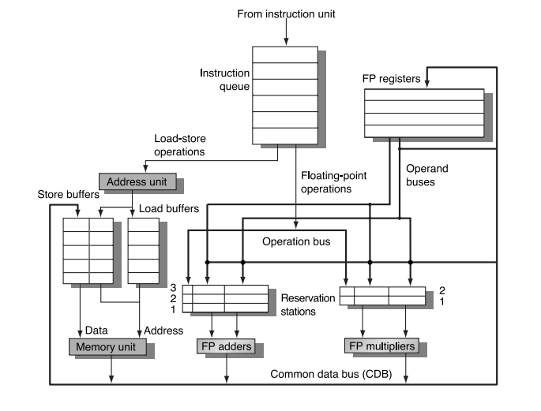
Quick Look
Source #2: Georgia Tech College of Computing

Slide 51
Tomasulo’s Three Stages
Issue—get instruction from FP Op Queue
If reservation station free, the scoreboard issues instr & sends operands (renames registers).
Execution—operate on operands (EX)
When both operands ready then execute; if not ready, watch CDB for result
Write result—finish execution (WB)
Write on Common Data Bus to all waiting units; mark reservation station available.

Slide 52
Example - Tomasulo’s
Instruction Queue
Register File
R1 = R2 + R3
R4 = R1 - R2
R1 = R2 / R3
R2 = R4 + R1
R1
3.14
-1.00
2.72
.71
R2
R3
R4
Register Alias Table
R1
RS3
RS4
RS1
+ .71 3.14
RS4
/ RS1 2.72
R2
RS1
- RS4 RS1
RS2
RS5
R3
RS3
+ RS1 2.72
R4
RS2
Mult
Add
Notes:
1st - take instruction from buffer
2nd - look if the inputs are available in the rat

Slide 53
Limitations to Tomasulo’s
Hardware additions
The basic algorithm does not account for branch prediction, hardware must be added
Many associative stores (CDB) at high speed
Performance limited by Common Data Bus
Each CDB must go to multiple functional units

Slide 54
Why would Tomasulo be a bad chemist?
Because he would have to keep reordering the buffer

Slide 55
Tomasulo’s and Scoreboarding - Differences
Control & buffers distributed with Function Units vs. centralized in scoreboard; called “reservation stations”
instructions schedule themselves
Registers in instructions replaced by pointers to reservation station buffer
scoreboard => registers primary operand storage
Tomasulo => reservation stations as operand storage
HW renaming of registers to avoid WAR, WAW hazards
Scoreboard => both source registers read together (thus one could not be overwritten while we wait for the other).
Tomasulo => each register read as soon as available.
Common Data Bus broadcasts results to all FUs
RS’s (FU’s), registers, etc. responsible for collecting own data off CDB
Load and Store Queues treated as FUs as well

Slide 56
References
"Recent Papers by IBM Authors." IBM Journal of Research and Development 24.2 (1980): 253-58. Web.
Georgia Tech Lecture - College of Computing: http://www.cc.gatech.edu/~milos/Teaching/CS6290F07/4_Tomasulo.pdf
Dartmouth College Lecture - College of Computing: engineering.dartmouth.edu/courses/engs116/.../engs%20116%20lecture%207-05f.ppt
Tomasulo, Robert M. (Jan 1967). "An Efficient Algorithm for Exploiting Multiple Arithmetic Units". IBM Journal of Research and Development. IBM. 11 (1): 25–33. doi:10.1147/rd.111.0025. ISSN 0018-8646.
Yoga, Adarsh. "Differences between Tomasulo's algorithm and dynamic scheduling in Intel Core microarchitecture". The boozier.

